Slide 1
Class 17 From Sets to Everything (or at least 2+2)
Test 2 is in class on Wednesday, 26 February. Preparation Guide with practice problems now posted.
Test 2 will be similar in format (and in allowing a page of notes) to Test 1 but will mostly focus on material from Classes 9-17 (today) and Problem Set 3 and 4. It might also include a problem based on the Test 1 Comments.

Slide 2
Plan
PS3 grades will be released soon!
PS4 comments will be released today.
Natural numbers from sets
Operations on the natural numbers: 2+2=4
Test 2 is in class on Wednesday, 26 February. Preparation Guide with practice problems now posted.
Test 2 will be similar in format (and in allowing a page of notes) to Test 1 but will mostly focus on material from Classes 9-17 (today) and Problem Set 3 and 4. It might also include a problem based on the Test 1 Comments.

Slide 3
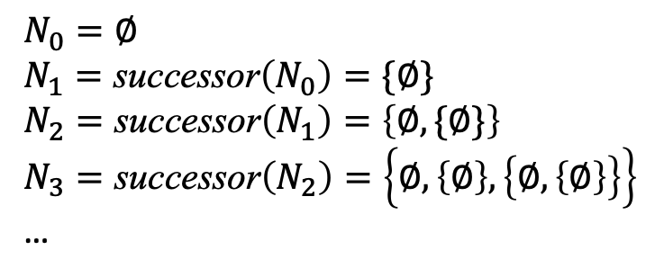
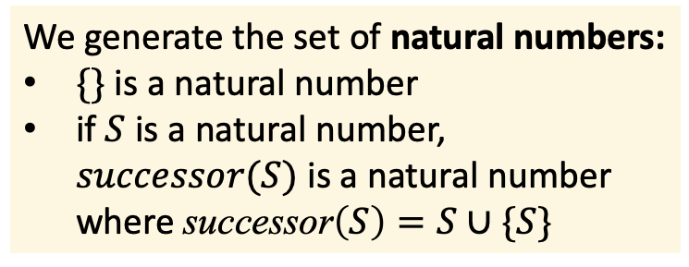
Recap: Defining Natural Numbers
We generate the set of natural numbers:
$\{\}$ is a natural number
if $S$ is a natural number, $successor(S)$ is a natural number where $\text{successor}\left(S\right)=S∪\{S\}$
$$N_{0}=∅$$
$$N_{1}=\text{successor}\left(N_{0}\right)=\{∅\}$$
$$N_{2}=\text{successor}\left(N_{1}\right)=\left\{∅, \{∅\}\right\}$$
$$N_{3}=\text{successor}\left(N_{2}\right)=\left\{∅, \left\{∅\right\}, \left\{∅, \left\{∅\right\}\right\}\right\}$$
…

Slide 4
Recap: Defining Natural Numbers
We generate the set of natural numbers:
$\{\}$ is a natural number
if $S$ is a natural number, $successor(S)$ is a natural number where $\text{successor}\left(S\right)=S∪\{S\}$
$$N_{0}=∅$$
$$N_{1}=\text{successor}\left(N_{0}\right)=\{∅\}$$
$$N_{2}=\text{successor}\left(N_{1}\right)=\left\{∅, \{∅\}\right\}$$
$$N_{3}=\text{successor}\left(N_{2}\right)=\left\{∅, \left\{∅\right\}, \left\{∅, \left\{∅\right\}\right\}\right\}$$
…
This shows that we can generate a set that has a bijection to our informal understanding of the Natural Numbers, but not that we can operate on them the ways we expect to operate on natural numbers
This isn’t really a definition!

Slide 5

Predicate Definitions
A noodle is a procrastinoodle if and only if it takes more than four hours to eat.
@Imagen3 draw a funny, creative artistic picture illustration style of a single person eating a single excessively long strand of spaghetti instead of working on their homework assignment

Slide 6
Predicate Definitions
A noodle is a procrastinoodle if and only if it takes more than four hours to eat.
An integer, $z$, is even if and only if there exists an integer $k$ such that $z = 2k$.
A number is rational if and only if it can be written as a ratio of two integers.
An inference rule is sound if and only if it can never be used to make a false conclusion.

Slide 7
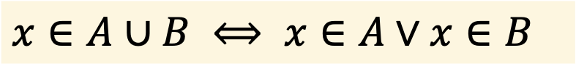
What about this definition?
$$x∈A∪B ⟺ x∈A∨x∈B$$

Slide 8
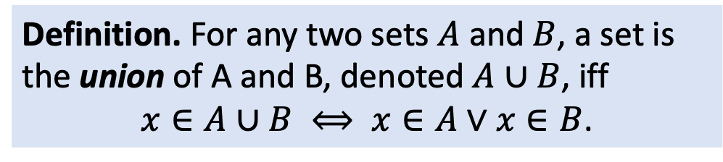
What about this definition?
$$x∈A∪B ⟺ x∈A∨x∈B$$
Definition. For any two sets $A$ and $B$, a set is the union of A and B, denoted $A∪B$, iff
$x∈A∪B ⟺ x∈A∨x∈B$.

Slide 9
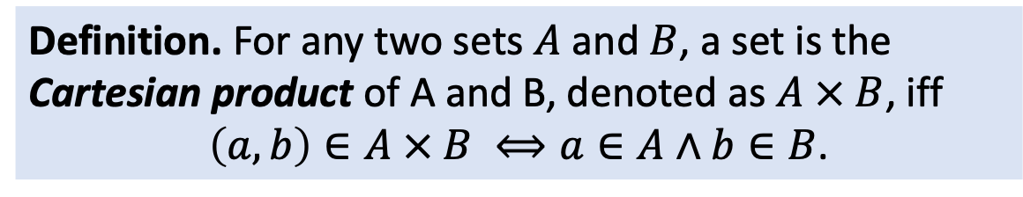
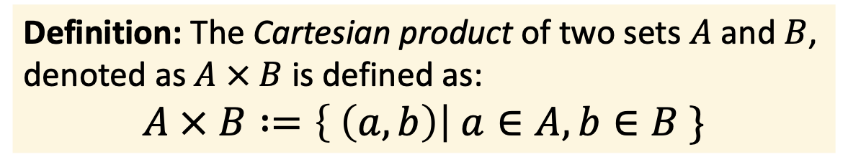
What about these definitions?
Definition: The Cartesian product of two sets $A$ and $B$, denoted as $A × B$ is defined as:
$$A × B :=\left\{ \left(a, b\right)\right| a∈A, b∈B \}$$
Definition. For any two sets $A$ and $B$, a set is the Cartesian product of A and B, denoted as $A × B$, iff
$\left(a, b\right)∈A × B ⟺a∈A∧b∈B$.

Slide 10

Constructive Definitions
To make a procrastinoodle:
Get a box of spaghetti and some edible, heat-resistant superglue
Glue all of the spaghetti strands together at their ends to make one extremely long strand.
Boil some water. Add lots of salt for better taste.
Cook for 7 minutes for al dente procrastinoodle.

Slide 11
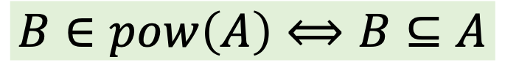
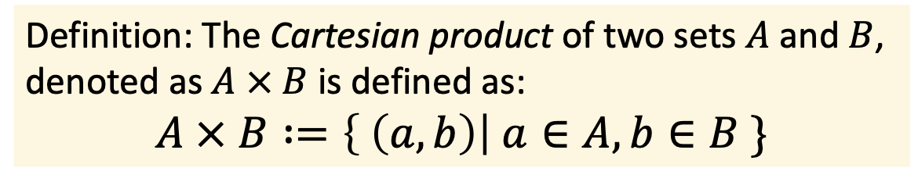
Constructive Definitions
Definition: The Cartesian product of two sets $A$ and $B$, denoted as $A × B$ is defined as:
$$A × B :=\left\{ \left(a, b\right)\right| a∈A, b∈B \}$$
$$B∈pow\left(A\right)⟺B⊆A$$

Slide 12
A Constructive+Predicate Definition

Slide 13
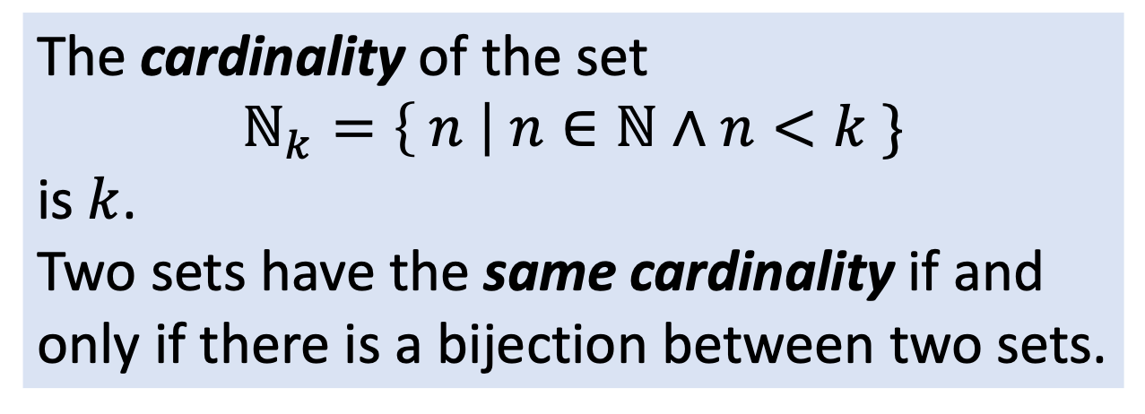
A Constructive+Predicate Definition
The cardinality of the set
$$ℕ_{k}=\left\{ n \right| n∈ℕ∧n<k \}$$
is $k$.
Two sets have the same cardinality if and only if there is a bijection between two sets.

Slide 14
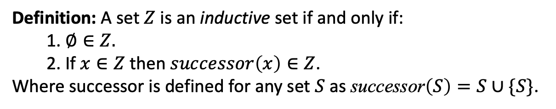
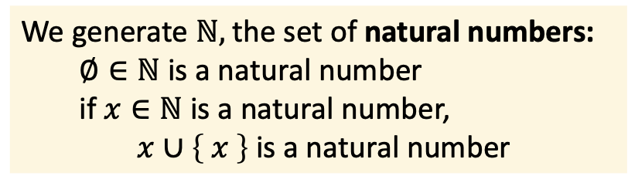
Defining the Natural Numbers
We generate $ℕ,$the set of natural numbers:
$∅∈ℕ$ is a natural number
if $x∈ℕ$ is a natural number,
$x∪\left\{ x \right\}$ is a natural number
This is a way to ”generate” all the natural numbers, but a clear definition of the set.
Definition: A set $Z$ is an inductive set if and only if:
1. $∅∈Z.$
2. If $x∈Z$ then $successor\left(x\right)∈Z$.
Where successor is defined for any set $S$ as $\text{successor}\left(S\right)=S∪\{S\}$.

Slide 15
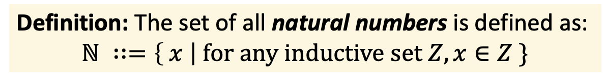
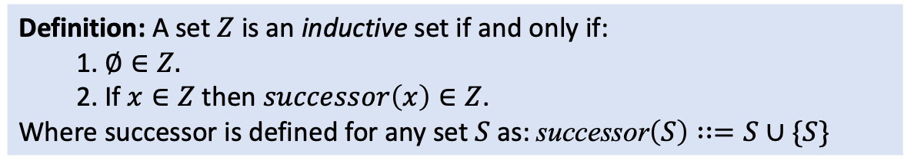
Defining the Natural Numbers
Definition: A set $Z$ is an inductive set if and only if:
1. $∅∈Z.$
2. If $x∈Z$ then $successor\left(x\right)∈Z$.
Where successor is defined for any set $S$ as: $\text{successor}\left(S\right)∷=S∪\{S\}$
Definition: The set of all natural numbers is defined as:
$$ℕ ∷=\left\{ x \right| \text{for} \text{any} \text{inductive} \text{set} Z, x∈Z \}$$

Slide 16
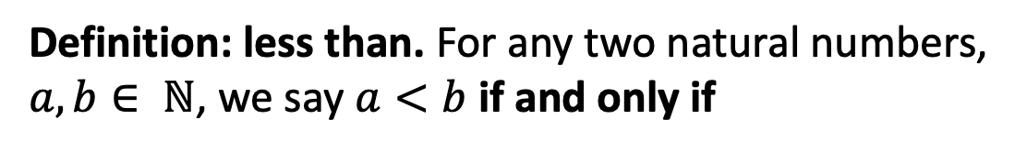
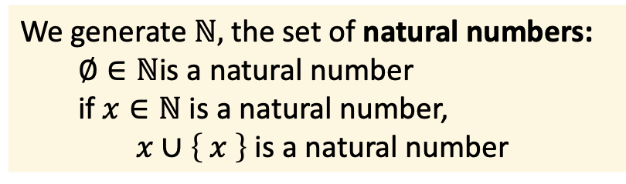
Operations on the Natural Numbers
Can we define “<“ meaning “less than” on the natural numbers?
We generate $ℕ,$the set of natural numbers:
$∅∈ℕ$is a natural number
if $x∈ℕ$ is a natural number,
$x∪\left\{ x \right\}$ is a natural number
Definition: less than. For any two natural numbers, $a, b∈ ℕ$, we say $a<b$ if and only if

Slide 17
Operations on the Natural Numbers

Slide 18
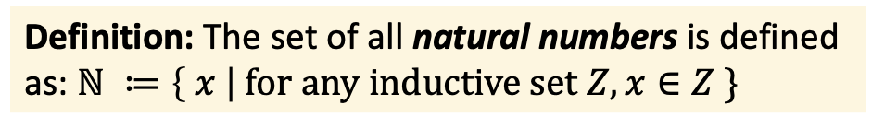
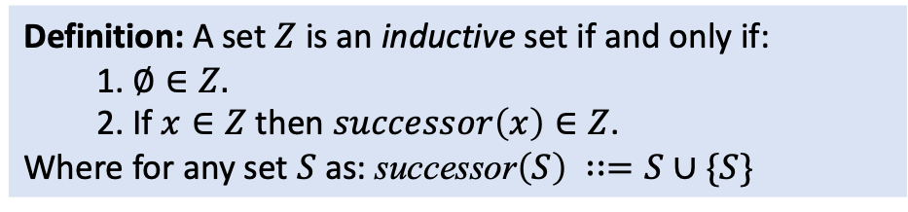
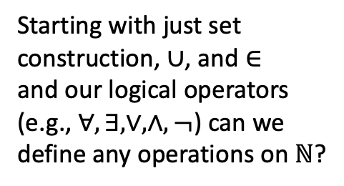
Defining Natural Number Operations
Definition: A set $Z$ is an inductive set if and only if:
1. $∅∈Z.$
2. If $x∈Z$ then $successor\left(x\right)∈Z$.
Where for any set $S$ as: $\text{successor}\left(S\right) ∷=S∪\{S\}$
Starting with just set construction, $∪$, and $∈$
and our logical operators (e.g., $∀, ∃, ∨, ∧, ¬$) can we define any operations on $ℕ$?
Definition: The set of all natural numbers is defined as: $ℕ ≔\left\{ x \right| \text{for} \text{any} \text{inductive} \text{set} Z, x∈Z \}$

Slide 19
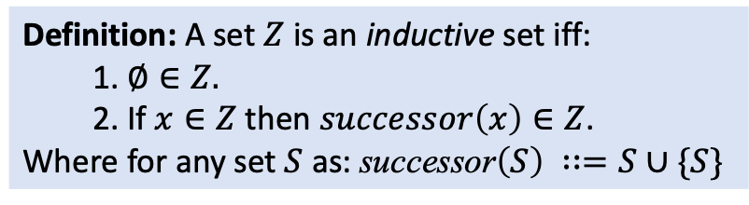
Operations on the Natural Numbers
Can we define “<“ meaning “less than” on the natural numbers?
Definition: A set $Z$ is an inductive set iff:
1. $∅∈Z.$
2. If $x∈Z$ then $successor\left(x\right)∈Z$.
Where for any set $S$ as: $\text{successor}\left(S\right) ∷=S∪\{S\}$
$$ℕ ≔\left\{ x \right| \text{for} \text{any} \text{inductive} \text{set} Z, x∈Z \}$$

Slide 20
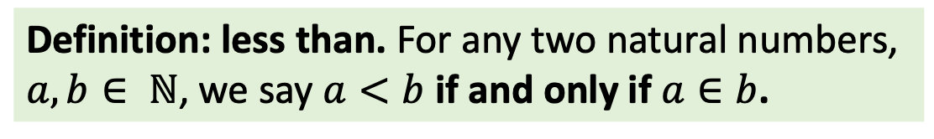
Operations on the Natural Numbers
Can we define “<“ meaning “less than” on the natural numbers?
Definition: less than. For any two natural numbers, $a, b∈ ℕ$, we say $a<b$ if and only if $a∈b$.
Definition: A set $Z$ is an inductive set iff:
1. $∅∈Z.$
2. If $x∈Z$ then $successor\left(x\right)∈Z$.
Where for any set $S$ as: $\text{successor}\left(S\right) ∷=S∪\{S\}$
$$ℕ ≔\left\{ x \right| \text{for} \text{any} \text{inductive} \text{set} Z, x∈Z \}$$

Slide 21
Defining Greater Than
Definition: A set $Z$ is an inductive set iff:
1. $∅∈Z.$
2. If $x∈Z$ then $successor\left(x\right)∈Z$.
Where for any set $S$ as: $\text{successor}\left(S\right) ∷=S∪\{S\}$
$$ℕ ≔\left\{ x \right| \text{for} \text{any} \text{inductive} \text{set} Z, x∈Z \}$$

Slide 22
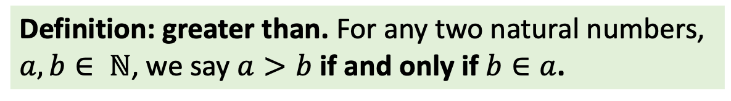
Defining Greater Than
Definition: greater than. For any two natural numbers, $a, b∈ ℕ$, we say $a>b$ if and only if $b∈a$.
Definition: A set $Z$ is an inductive set iff:
1. $∅∈Z.$
2. If $x∈Z$ then $successor\left(x\right)∈Z$.
Where for any set $S$ as: $\text{successor}\left(S\right) ∷=S∪\{S\}$
$$ℕ ≔\left\{ x \right| \text{for} \text{any} \text{inductive} \text{set} Z, x∈Z \}$$

Slide 23
Defining Equal
Definition: A set $Z$ is an inductive set iff:
1. $∅∈Z.$
2. If $x∈Z$ then $successor\left(x\right)∈Z$.
Where for any set $S$ as: $\text{successor}\left(S\right) ∷=S∪\{S\}$
$$ℕ ≔\left\{ x \right| \text{for} \text{any} \text{inductive} \text{set} Z, x∈Z \}$$

Slide 24
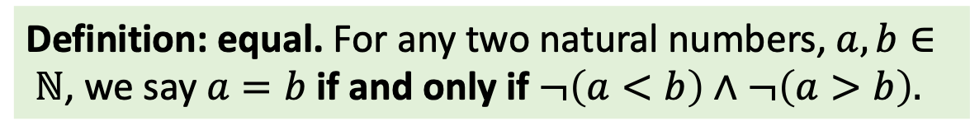
Defining Equal
Definition: equal. For any two natural numbers, $a, b∈ ℕ$, we say $a=b$ if and only if $¬\left(a<b\right)∧¬\left(a>b\right).$
Definition: A set $Z$ is an inductive set iff:
1. $∅∈Z.$
2. If $x∈Z$ then $successor\left(x\right)∈Z$.
Where for any set $S$ as: $\text{successor}\left(S\right) ∷=S∪\{S\}$
$$ℕ ≔\left\{ x \right| \text{for} \text{any} \text{inductive} \text{set} Z, x∈Z \}$$

Slide 25
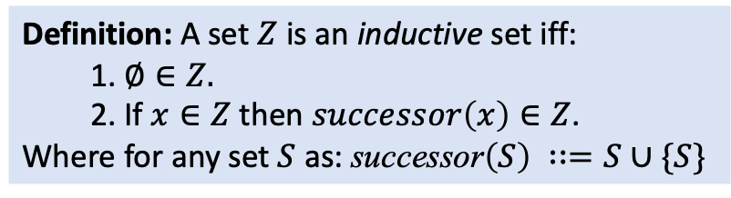
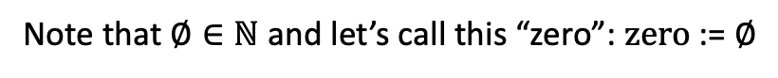
Can Compare, but can we ADD?
Definition: A set $Z$ is an inductive set iff:
1. $∅∈Z.$
2. If $x∈Z$ then $successor\left(x\right)∈Z$.
Where for any set $S$ as: $\text{successor}\left(S\right) ∷=S∪\{S\}$
$$ℕ ≔\left\{ x \right| \text{for} \text{any} \text{inductive} \text{set} Z, x∈Z \}$$
Note that $∅∈ℕ$ and let’s call this “zero”: $\text{zero}$ := $∅$

Slide 26
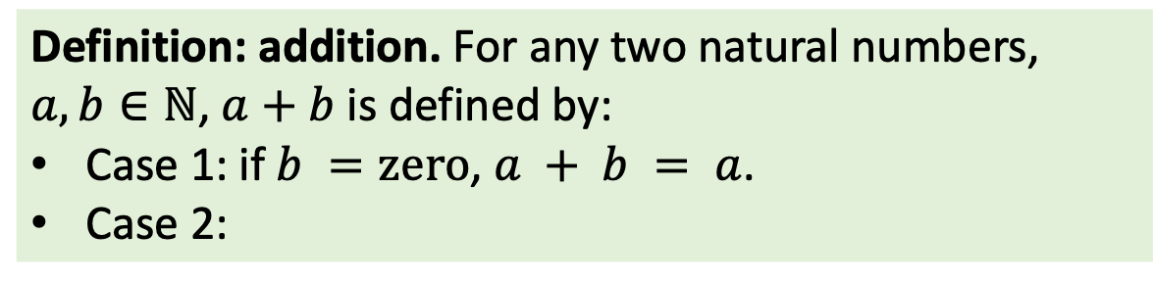
Defining Addition on Natural Numbers
Definition: addition. For any two natural numbers, $a, b∈ℕ$, $a+b$ is defined by:
Case 1: if $b =\text{zero}$, $a + b = a$.
Case 2:
Definition: A set $Z$ is an inductive set iff:
1. $∅∈Z.$
2. If $x∈Z$ then $successor\left(x\right)∈Z$.
Where for any set $S$ as: $\text{successor}\left(S\right) ∷=S∪\{S\}$
$$ℕ ≔\left\{ x \right| \text{for} \text{any} \text{inductive} \text{set} Z, x∈Z \}$$
Note that $∅∈ℕ$ and let’s call this “zero”: $\text{zero}$ := $∅$

Slide 27
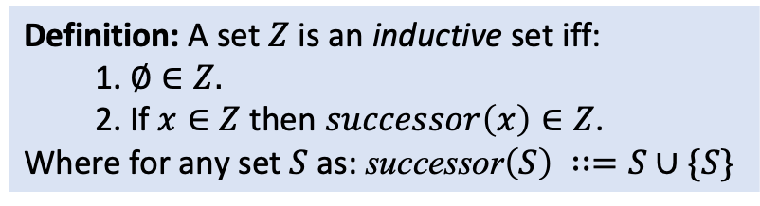
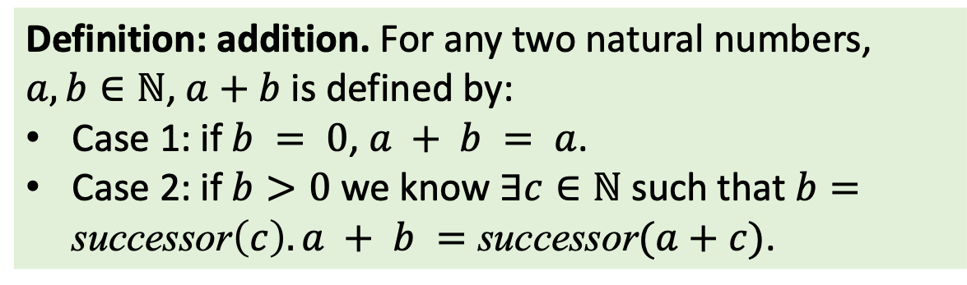
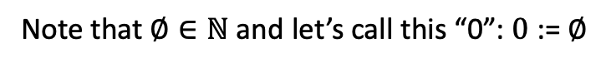
Defining Addition on Natural Numbers
Definition: addition. For any two natural numbers, $a, b∈ℕ$, $a+b$ is defined by:
Case 1: if $b = 0$, $a + b = a$.
Case 2: if $b>0$ we know $∃c∈ℕ$ such that $b=\text{successor}\left(c\right). a + b =\text{successor}(a+c)$.
Definition: A set $Z$ is an inductive set iff:
1. $∅∈Z.$
2. If $x∈Z$ then $successor\left(x\right)∈Z$.
Where for any set $S$ as: $\text{successor}\left(S\right) ∷=S∪\{S\}$
$$ℕ ≔\left\{ x \right| \text{for} \text{any} \text{inductive} \text{set} Z, x∈Z \}$$
Note that $∅∈ℕ$ and let’s call this “0”: $0$ := $∅$

Slide 28
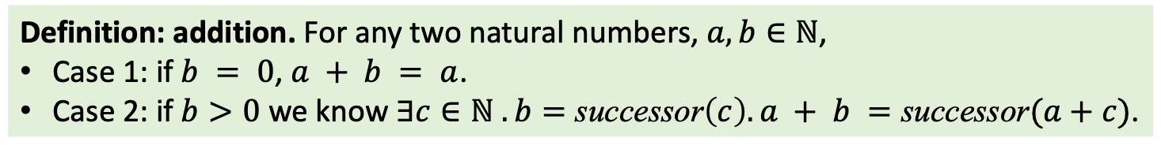
2 + 2 = 4?
Definition: addition. For any two natural numbers, $a, b∈ℕ$,
Case 1: if $b = 0$, $a + b = a$.
Case 2: if $b>0$ we know $∃c∈ℕ . b=\text{successor}\left(c\right). a + b =\text{successor}(a+c)$.

Slide 30
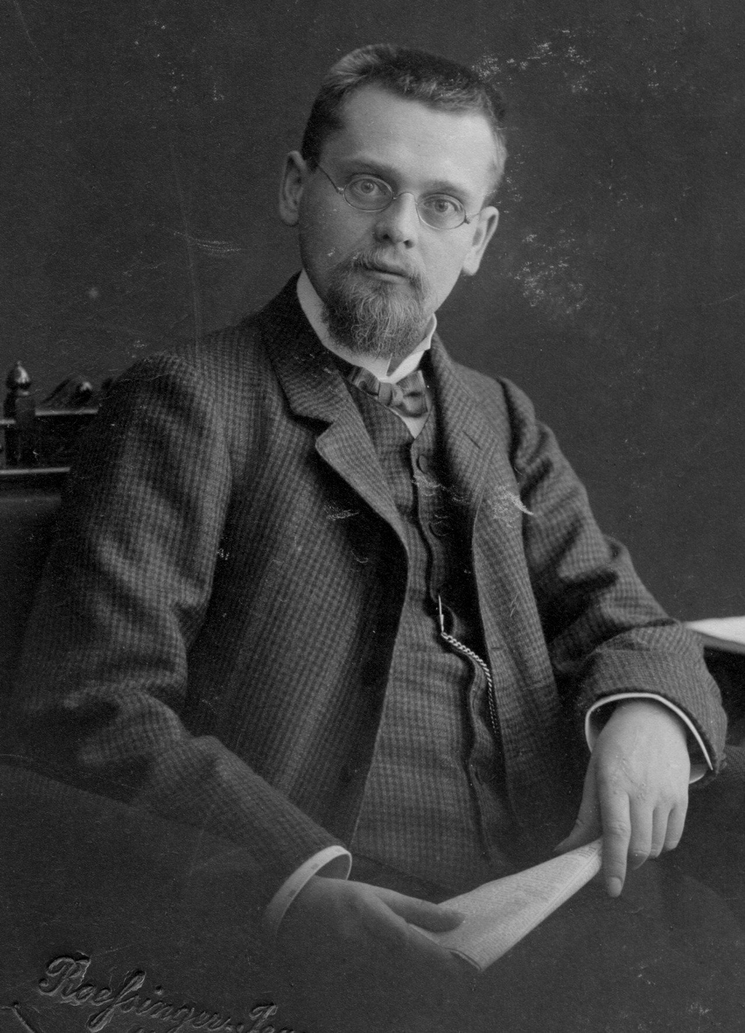
Z Axioms
Zermelo’s System
Ernst Zermelo (1871-1953)
Pictured in 1907
Based on https://encyclopediaofmath.org/index.php?title=ZFC and https://mathworld.wolfram.com/Zermelo-FraenkelAxioms.html not MCS Section 8.3.2

Slide 31
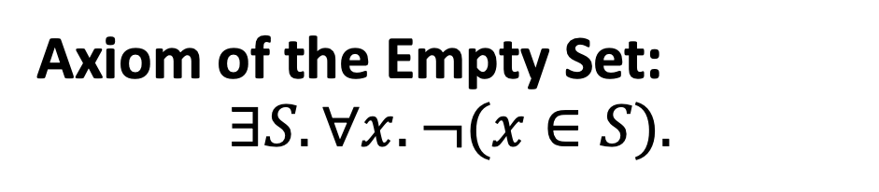
Z Axioms
Zermelo’s System
Axiom of the Empty Set:
$$∃S. ∀x. ¬(x∈S).$$
Ernst Zermelo (1871-1953)
Pictured in 1907
Based on https://encyclopediaofmath.org/index.php?title=ZFC and https://mathworld.wolfram.com/Zermelo-FraenkelAxioms.html not MCS Section 8.3.2

Slide 32
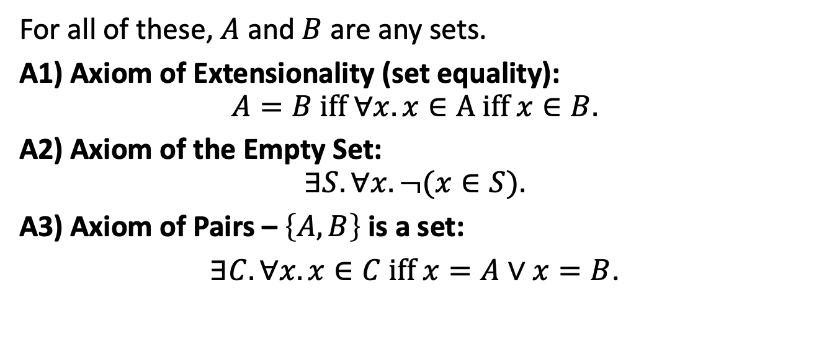
Z Axioms
Zermelo’s System
For all of these, $A$ and $B$ are any sets.
A1) Axiom of Extensionality (set equality):
$$A=B iff ∀x. x∈A iff x∈B.$$
A2) Axiom of the Empty Set:
$$∃S. ∀x. ¬(x∈S).$$
A3) Axiom of Pairs – $\left\{A,B\right\}$ is a set:
$∃C. ∀x. x∈C iff x=A∨x=B$.
Ernst Zermelo (1871-1953)
Pictured in 1907
Based on https://encyclopediaofmath.org/index.php?title=ZFC and https://mathworld.wolfram.com/Zermelo-FraenkelAxioms.html not MCS Section 8.3.2

Slide 33
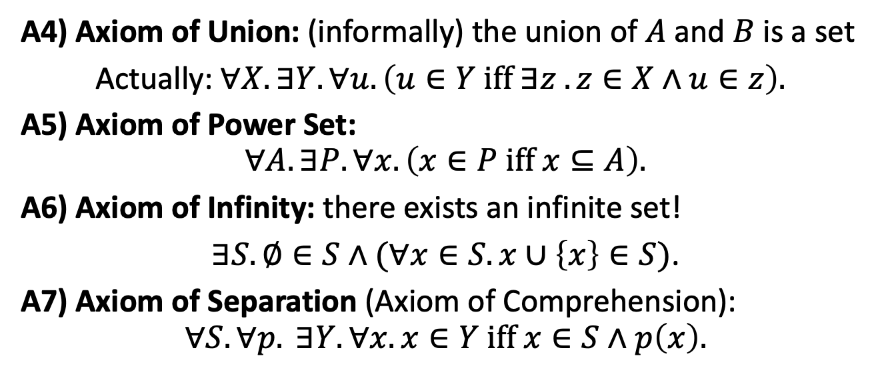
Z Axioms
A4) Axiom of Union: (informally) the union of $A$ and $B$ is a set
Actually: $∀X. ∃Y. ∀u. \left(u∈Y iff ∃z . z∈X∧u∈z\right).$
A5) Axiom of Power Set:
$$∀A. ∃P. ∀x. \left(x∈P iff x⊆A\right).$$
A6) Axiom of Infinity: there exists an infinite set!
$∃S. ∅∈S∧(∀x∈S. x∪\left\{x\right\}∈S)$.
A7) Axiom of Separation (Axiom of Comprehension):
$$∀S.∀p. ∃Y. ∀x. x∈Y iff x∈S∧p\left(x\right).$$

Slide 34
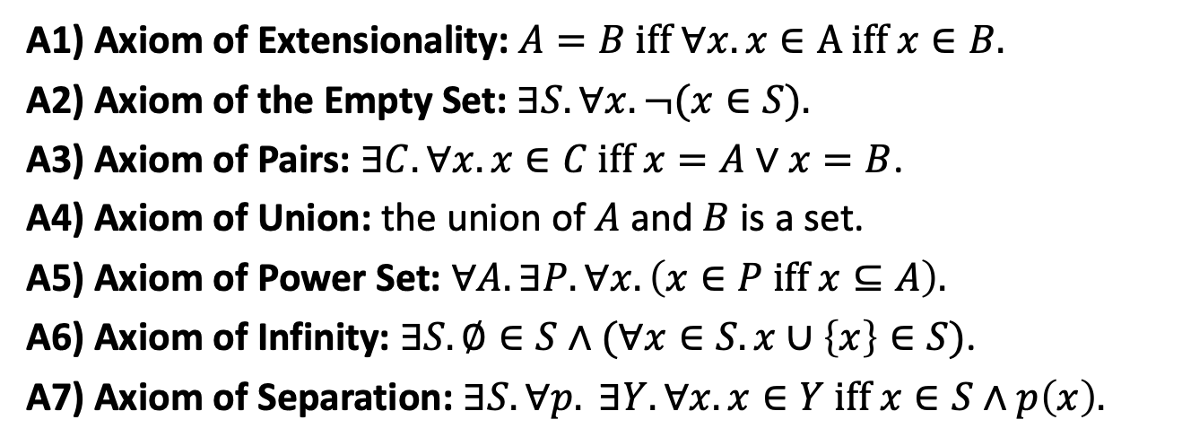
Are Zermelo’s 7 axioms “enough”?
A1) Axiom of Extensionality: $A=B iff ∀x. x∈A iff x∈B.$
A2) Axiom of the Empty Set: $∃S. ∀x. ¬(x∈S).$
A3) Axiom of Pairs: $∃C. ∀x. x∈C iff x=A∨x=B$.
A4) Axiom of Union: the union of $A$ and $B$ is a set.
A5) Axiom of Power Set: $∀A. ∃P. ∀x. \left(x∈P iff x⊆A\right).$
A6) Axiom of Infinity: $∃S. ∅∈S∧(∀x∈S. x∪\left\{x\right\}∈S)$.
A7) Axiom of Separation: $∃S.∀p. ∃Y. ∀x. x∈Y iff x∈S∧p\left(x\right).$

Slide 35
ZF+C Axioms
Add two more axioms (Abraham Fraenkel):
A8) Axiom Schema of Replacement
A9) Axiom of Foundation
+ Choice
A10) Axiom of Choice

Slide 36
Charge
Test 2 is in class Wednesday
Practice problems in the Preparation Guide
Monday:
If you want anything reviewed or have any questions about the practice problems, send them before 7pm on Sunday

